Slide 1



Independent Verification of DLIs for 16 Municipal Committees and Third-Party Monitoring of Environmental & Social Management under PICP
Client
LOCAL GOVERNMENT & COMMUNITY DEVELOPMENT DEPARTMENT (LG&CDD)
Consultant:
SKAFS Consultants Pvt Ltd
Date: 7 April , 2026

Slide 2
Project Overview
MANDATE
Independently verify annual achievement of all six DLIs (except year 1 for full IVA cycle).
Assess annual performance of participating local governments against Minimum Access Conditions (MACs) and Performance Measures (PMs).
Support transparent disbursement decisions through evidence-based verification.
Third party monitoring of environmental and social compliance under both PforR and IPF components.
Urban local governments face service delivery, financing, institutional, and climate-related gaps—especially in WASH, SWM, revenue mobilization, and governance.
The Punjab Inclusive Cities Program (PICP) is a World Bank-funded initiative aimed at improving safely managed water, sanitation, and hygiene services, while strengthening the institutional and financial performance of selected urban local cities in Punjab..
This assignment covers Independent Verification and Third-Party Monitoring under PICP. The consultant will provide evidence-based assessment of annual results achieved by participating Municipal Committees, including compliance with institutional, environmental, and social requirements.
Geographic coverage – 16 Cities
Ahmedpur East
Arifwala
Chakwal
Chishtian
Haroonabad
Jampur
Kasur
Khanpur
Mandi Bahauddin
Rajanpur
Sadiqabad
Samundri
Chiniot
Jatoi
Pakpattan
Shujabad

Slide 3
Guiding Principles of the Technical Approach
1
Independence & Objectivity
2
Evidence-Based Verification
3
Triangulation & Reconciliation
Standardized protocols, documented procedures, expert review, and impartial conclusions.
Documentary, institutional, financial, physical, and stakeholder evidence for every finding.
Cross-checking across ULG, PMDFC, MIS, contracts, financial records, and field observations.
4
Risk-Based Problem Solving
5
Synchronization with Program Cycles
6
Action-Oriented Reporting
Enhanced scrutiny for high-risk areas such as WASH connections, procurement, SWM, revenue, and E&S.
Annual verification aligned to the disbursement cycle; E&S monitoring aligned to quarterly reporting.
Clear compliance status plus practical corrective actions and institutional improvement measures.

Slide 4
Disbursement Linked Indicators (DLIs) of PICP
RESULTS AREA | PURPOSE | INDICATOR
Safely managed water, sanitation, drainage, and basic hygiene services | Provide safely managed water, sanitation, drainage, and basic hygiene services in ULGs | DLI 1: Safely managed water and sanitation connections provided in eligible ULGs
 | Support the Suthra Punjab provincial program to improve solid waste management services | DLI 2: Improved performance of solid waste management systems in Punjab
Institutional strengthening and financial sustainability | Ensure WATSAN units in Program ULGs fulfil minimum conditions for sustainable service delivery | DLI 3: Participating ULGs (other than Chakwal and Kasur) meeting Minimum Access Conditions for WSS service delivery
 | Strengthen governance, institutional, and financing mechanisms for sustained service delivery and cost recovery | DLI 4: Eligible ULGs achieving improved scores on Institutional Performance Indicators
 | Incentivize increased revenue collection in Program ULGs | DLI 5: Increased revenues in eligible ULGs from taxes, fees, and tariffs compared to FY 2023–24
 | Mobilize private sector resources for WSS service delivery in secondary cities | DLI 6: Number of PPP transactions processed in the WSS sector in two participating ULGs

Slide 5
what we will verify and monitor
DLI 1
DLI 2
DLI 3–5
DLI 6 + E&S
Water & sewerage
connections
SWM system performance
MACs, PMs & revenue
PPP contract &
E&S compliance
Contracts, reported connections, sample household validation, functionality, and quality checks.
PDD/MRV rollout, WMC revenue vs recurrent cost, landfill SOPs, SWM regulations.
MAC compliance, PM scoring, audited statements, tariff/tax/fee revenue validation.
PPP contract review under Punjab PPP Act 2025; ESCF, ESIA/ESMP/RAP/GRM and field compliance.
Notes:
[Sources] - TOR.pdf, DLI descriptions and verification methodology, pp. 89–102. - TOR.pdf, E&S Third-Party Monitoring scope and responsibilities, pp. 102–104.

Slide 6
Our understanding of the assignment – Integrated Methodology Framework
Common platform: mobilization • tools & templates • evidence registers • QA protocols • dashboard reporting
Workstream 1: Annual IVA / APA Verification
Workstream 2: Quarterly E&S Third-Party Monitoring
Verify DLI 1, 3, 4 and 5 annually; verify DLI 2 and DLI 6 on a rolling basis as results become available.
Use paper audits, site inspections, household checks, water/wastewater quality testing, stakeholder verification and documentary review.
Determine compliance with Minimum Access Conditions and score Performance Measures for disbursement allocation.
Quarterly third-party monitoring of environmental and social management for PforR and IPF components.
Check E&S compliance framework, screening and categorization, safeguard instruments, GRM (Grievance Redress Mechanism), Stakeholder consultations, staffing and field compliance.
Provide findings, recommendations, and completion report to strengthen continuous compliance.
Outputs: verified results, compliance insights, funding implications, corrective action tracking
Notes:
[Sources] - TOR.pdf, Scope of work for IVA, pp. 89–90. - TOR.pdf, Annual Performance Assessment and duties, pp. 90–101. - TOR.pdf, Scope of Work for E&S Third-Party Monitoring and duties, pp. 102–104.

Slide 7
Overall technical approach for IVA and E&S third-party monitoring
Stream A
IVA / APA / DLI verification
Stream B
Quarterly E&S TPM
Mobilization
Inception and
tool finalization
Desk review & Secondary data collection form PMDFC records , Supervision firm monitoring reports and MIS/dashboard data (where available)
Data validation & reconciliation Field verification & Spot Check
MAC / PM scoring
ESCF review
Site inspections
Stakeholder Consultation and Ground validation
Quarterly findings
The Consultant will develop sampling method and standardized verification instruments including DLI verification sheets, field inspection checklists, MAC compliance tools, PM scoring matrices, financial verification formats, and E&S/GRM assessment templates in line with POM requirements in consultation with client and to World Bank satisfaction.
Draft IVA report +
reconciliation
Quarterly TPM reports
Final
reco.
Outputs support verified results, budget-linked allocations, and corrective action tracking.
Notes:
[Sources] - TOR.pdf objective and scope: IVA is responsible for annual evidence-based verification of DLIs, while E&S TPM evaluates adequacy and effectiveness of environmental and social management and provides recommendations. - TOR.pdf management cycle: annual APA aligns with the budgeting cycle and E&S management performance is assessed quarterly.

Slide 8
Verification Instruments & Tools
TOR-based instruments that structure data collection, assessment, scoring, and reporting across all workstreams.
Standardized tools ensure consistency, traceability, and auditable verification across DLI, MAC, PM, financial, and E&S assessments - Compliance with POM protocols.
Field Data Collection Tools
DLI verification sheets for DLI 1–6
Field inspection and spot-check checklists
Household / connection verification forms
Water and wastewater test recording formats
Assessment, Scoring & Reporting Tools
MAC compliance assessment tools
PM scoring matrices and scoring logs
Financial verification templates for taxes, fees, and tariffs
E&S and GRM assessment formats, evidence registers, and reporting templates
Data Collection tool
Validation & Reconciliation tool
Assessment & Scoring tool
Reporting & Evidence tool
Notes:
[Sources] - TOR.pdf objective and scope: IVA is responsible for annual evidence-based verification of DLIs, while E&S TPM evaluates adequacy and effectiveness of environmental and social management and provides recommendations. - TOR.pdf management cycle: annual APA aligns with the budgeting cycle and E&S management performance is assessed quarterly.

Slide 9
Technology-Enabled Verification Framework – Innovation
The TOR requires development of verification tools and instruments, the Consultant proposes a technology-enabled digital verification system to enhance efficiency, transparency, and accuracy of the verification process.
Field Efficiency - Offline data collection forms with Synchronized upload geotagged photo evidence and GPS tagging at each verified site
Data integrity - Central evidence repository and version-controlled records
Automated checks, validation logs, QA checks and audit trail, flagged issues
Real-time data sync and Dashboard-based progress tracking by ULG / indicator, teams and verification status
Integration with MIS / MRV systems
Data Collection – Field Teams ( Kobo toolbox / Custom Mobile
Geo-tagged Data Capture & Field Verification
Central server Database ( kobo tool box/Custom Database)
Dashboard Reporting and verification
Every verification will be geo-tagged, time-stamped, and fully auditable.
Notes:
[Sources] - TOR.pdf objective and scope: IVA is responsible for annual evidence-based verification of DLIs, while E&S TPM evaluates adequacy and effectiveness of environmental and social management and provides recommendations. - TOR.pdf management cycle: annual APA aligns with the budgeting cycle and E&S management performance is assessed quarterly.

Slide 10
Internal quality assurance and review process
Field data
collection
Supervisor
review
Technical
validation
Back-checks and
QA review
Evidence
reconciliation
Final sign-off
and reporting
No finding is reported without documentary support, specialist validation, and internal QA review before submission.
Notes:
[Sources] - TOR.pdf allows PSC and the World Bank to seek re-verification, rectification, or return results if anomalies or significant discrepancies are found; a documented internal QA process directly responds to the TOR requirement for robust and reviewable verification results.

Slide 11
Annual IVA / APA Verification Cycle
Verification planning
Desk review
Validation
Field verification
1
2
3
4
Map each DLI, DLR, MAC and PM to evidence, sources, field checks and outputs.
Collect reports, contracts, audits, revenue data, procurement records and MIS outputs.
Cross-check, reconcile discrepancies and issue clarification sheets.
Observe assets, verify connections, inspect records, conduct spot checks and interviews.
Indicator assessment
Scoring & allocation
Reporting
6
7
5
7
Apply protocols for DLI 1–6 including SWM, revenue and PPP verification.
Determine achievement, MAC compliance, PM scores and funding implications.
Submit draft, reconciled and final reports to the Client and World Bank.
Deep-dive verification areas: WASH connections • SWM performance • MAC/PM scoring • revenue growth • PPP transactions

Slide 12
Quarterly Environmental & Social Monitoring Cycle
1
2
3
4
5
6
Framework review
Systems review
Site inspections
Stakeholder validation
Compliance classification
Quarterly reporting
Review ESCF, ESMPs, ESIAs, RAP/ARAP, RPF, LMP, SEP and applicable legal / WB requirements.
Assess staffing, screening, safeguards in bidding documents, internal reporting and GRM systems.
Consult affected communities, workers, women and other stakeholders to confirm ground realities.
Classify findings as compliant, partially compliant, non-compliant, or critical and assign follow-up actions.
Submit quarterly monitoring reports and a completion report capturing trends, unresolved issues and systemic recommendations.
Implement risk-based field inspections covering OHS, mitigation measures, community safety and waste/wastewater controls.
Quarterly cycle repeats across sampled cities and feeds corrective action tracking

Slide 13
Quarterly environmental and social monitoring cycle
Review ESCF and
safeguard instruments
Select sites
and sample
Inspect field
compliance
Consult citizens, workers, and end-users
+ confirm GRM / stakeholder engagement
Quarterly report +
corrective actions
Classify issues
and gaps
Repeat every quarter with follow-up on previously flagged issues.
Notes:
[Sources] - TOR.pdf third-party monitoring scope: review ESCF and safeguard instruments, screen and categorize investments, verify GRM and stakeholder consultations, monitor compliance with PEQS, perform site visits and environmental sampling, gather feedback from citizens and workers, identify areas for improvement, and issue quarterly and completion reports. - TOR.pdf management cycle: E&S performance is assessed quarterly.

Slide 14
Team structure and reporting lines
Client interface: LG&CDD / PMDFC / PSC / World Bank
Team Leader / M&E Specialist
Infrastructure and verification
Infrastructure specialist + field teams
Finance and institutional
Finance + institutional strengthening
E&S and social
E&S, social, OHS, gender
Enumerators / site inspectors
Analysis and report cell
QA / peer review
Notes:
[Sources] - TOR.pdf staffing table includes Team Leader / M&E Specialist, Infrastructure Specialist, Environment & Social Management Specialist, Finance & Account Specialist, Institutional Strengthening Specialist, Social Development Specialist, Occupational Health and Safety Specialist, Gender Specialist, and assistant team members. - TOR.pdf management states the consultants report to LG&CDD and work closely with PMDFC.

Slide 15
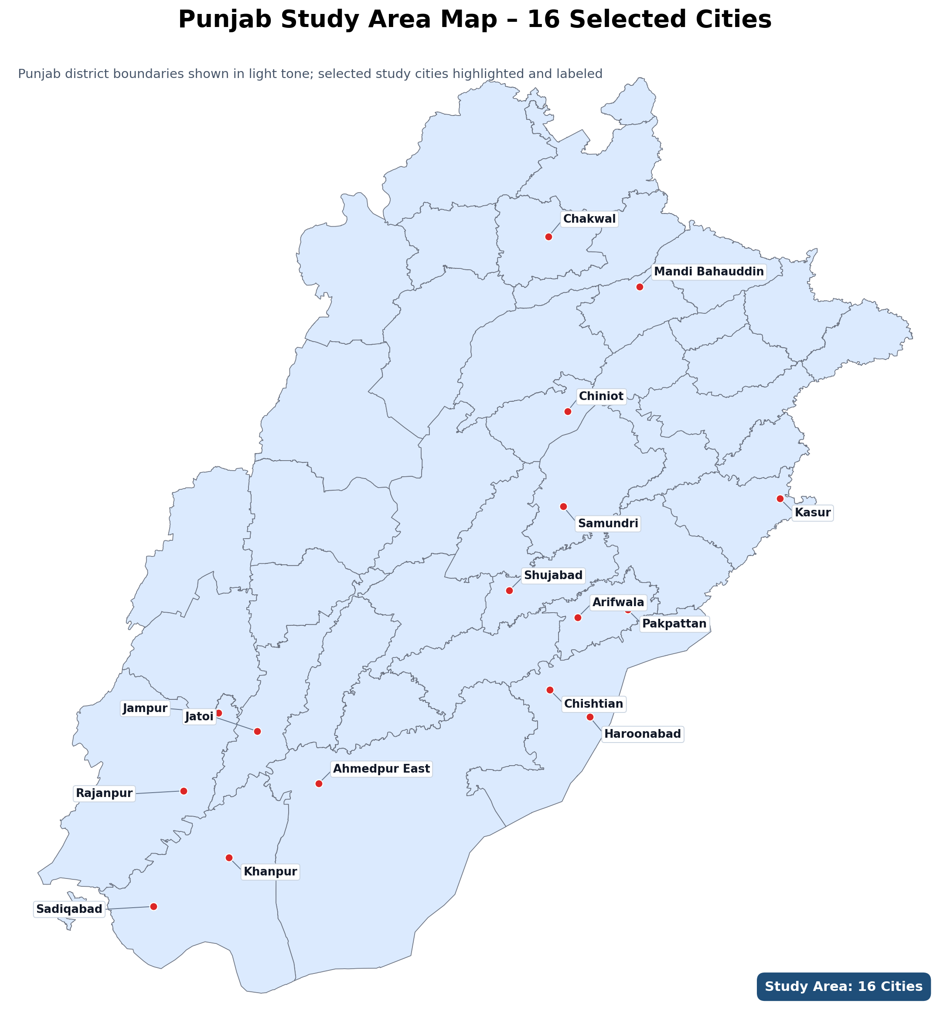
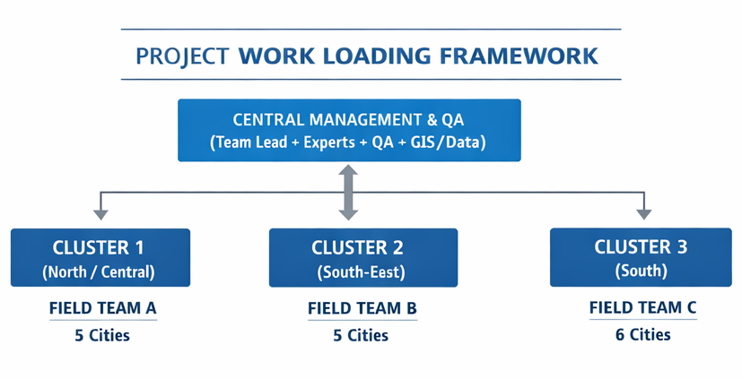
Core Team and Staffing (TOR-Aligned)
Key Experts (34 person-months)
- Team Leader / M&E Specialist (01, 2.5 PM)
- Infrastructure Specialist (01, 2.5 PM)
- Environment and Social Specialist (01, 6 PM)
- Finance and Accounts Specialist (01, 2.5 PM)
- Institutional Strengthening Specialist (01, 2.5 PM)
- Social Development Specialist (01, 6 PM)
- OHS Specialist (01, 6 PM)
- Gender Specialist (01, 6 PM)
Non-Key Experts (16 person-months)
- Assistant Team Member Infrastructure (02, 5 PM)
- Assistant Team Member E&S (01, 6 PM)
- Assistant Team Member Finance and Accounts (01, 2.5 PM)
- Assistant Team Member Institutional Strengthening (01, 2.5 PM)
Total Staffing Input: 50 person-months
Notes:
[Sources] - TOR.pdf staffing table includes Team Leader / M&E Specialist, Infrastructure Specialist, Environment & Social Management Specialist, Finance & Account Specialist, Institutional Strengthening Specialist, Social Development Specialist, Occupational Health and Safety Specialist, Gender Specialist, and assistant team members. - TOR.pdf management states the consultants report to LG&CDD and work closely with PMDFC.

Slide 16
Quality Assurance, Team Management and Reporting
Internal Quality Regime
Delivery Team Structure
Reporting Architecture
Standardized tools and protocols
Field-team orientation before deployment
Daily debriefing and issue escalation
Supervisory checks and sample back-checks
Senior expert validation of scores and findings
Document control and evidence archiving
Peer review before every submission
Comment reconciliation matrix for Client / World Bank feedback
Inception report
Quarterly E&S reports
Completion report
Draft IVA reports
Final IVA report
City-wise status tracking
Evidence registers and issue logs
KPI-style progress summaries
Team Lead
Verification specialists
E&S experts
Financial and procurement reviewers
Institutional Strengthening Specialist Social Development Specialist
Occupational Health and Safety Specialist / Central quality control and evidence management
Gender Specialist
Field coordinators and support staff

Slide 17
Work Plan and Key Performance Indicators
Contract start-up, mobilization, kick-off, tool development, work planning, inception report
Illustrative KPI targets
Phase 1
Inception & Setup
100%
Required reports delivered within TOR timelines
Quarterly E&S Monitoring
Framework review, sampling, site inspections, consultations, compliance analysis, reporting
100%
Coverage of all required PICP cities / ULGs
Phase 2
≥95%
Findings supported by complete and traceable evidence
Phase 3
Annual APA / IVA Cycle
Evidence collection, field verification, scoring, allocation analysis, draft/final submissions
≥98%
Data completeness and internal consistency
Close-out reporting, issue reconciliation, evidence archiving, editable files handover
10–15%
Supervisory back-check / peer review coverage
Phase 4
Finalization & Handover
100%
Discrepancies logged, tracked and dispositioned
Management focus: timeliness, readiness, full field coverage, evidence quality, reconciliation rigor, and decision-usefulness

Slide 18
Figure 8. Assignment work plan and delivery timeline
Annual and quarterly cycles aligned with TOR and budgeting milestones
Illustrative annual cycle
Jul
Aug
Sep
Oct
Nov
Dec
Jan
Feb
Mar
Apr
May
Jun
Mobilization / inception
Tool finalization + document requests
Quarterly E&S monitoring
APA / DLI verification window
Draft IVA report + reconciliation
Final report supports budget-linked allocations
Q1
Q2
Q3
Q4
This timeline demonstrates synchronization of quarterly E&S TPM reporting with the November-April APA verification window and May submissions.
Notes:
[Sources] - TOR.pdf annual management cycle: APA is synchronized with the government budgeting cycle; IVA verifies DLIs between November and April and communicates results by no later than April, supporting allocations reflected in June budgets. - TOR.pdf third-party monitoring cycle: E&S performance is assessed quarterly, with quarterly TPM reports and a completion report.

